Slide 1
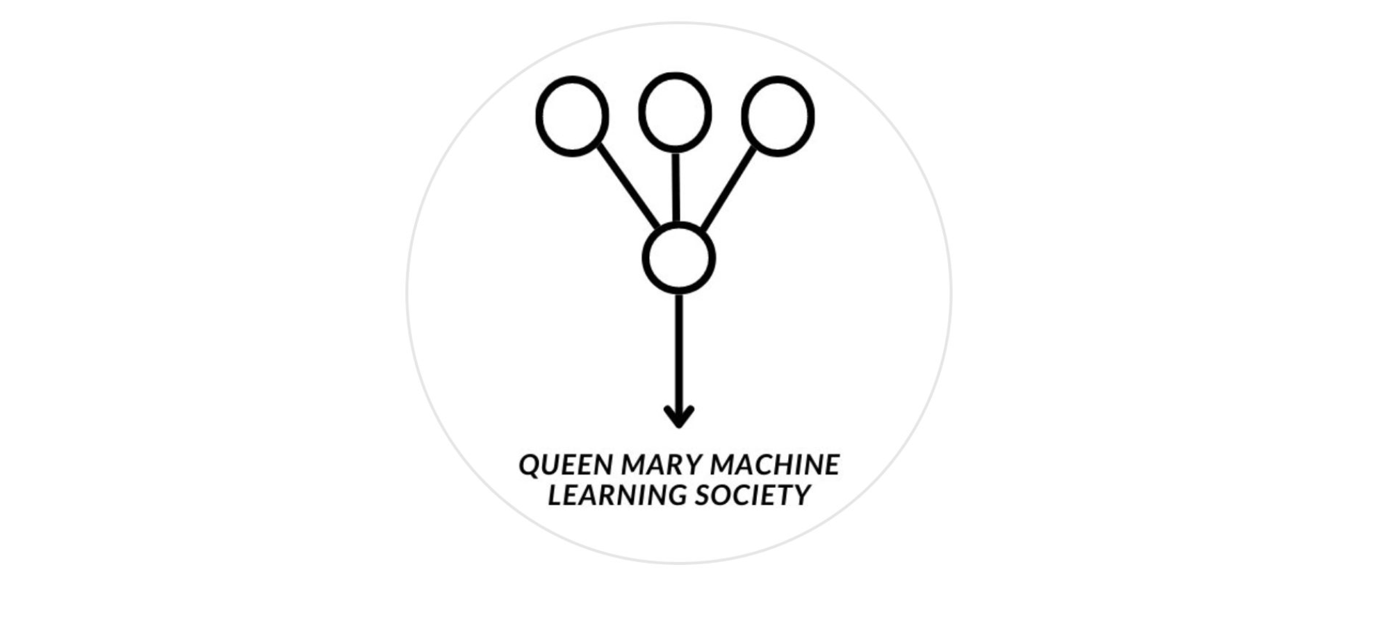
Kaggle #02

Slide 2
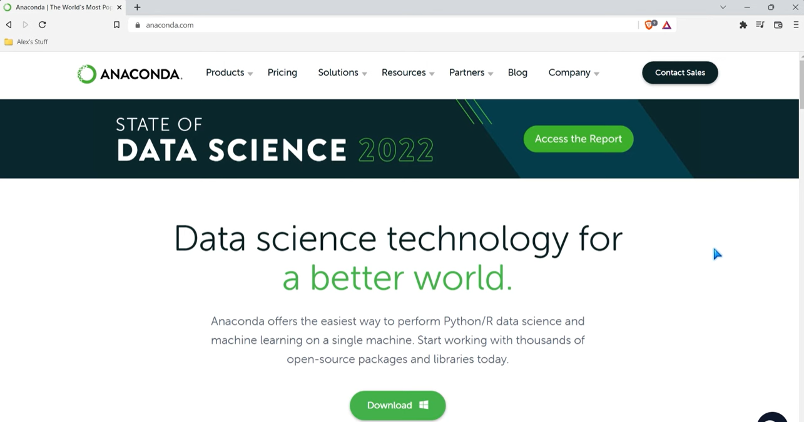
Downloading Anaconda and Jupyter notebook
Follow Alex Analyst’s tutorial : https://www.youtube.com/watch?v=WUeBzT43JyY&t=232s

Slide 3
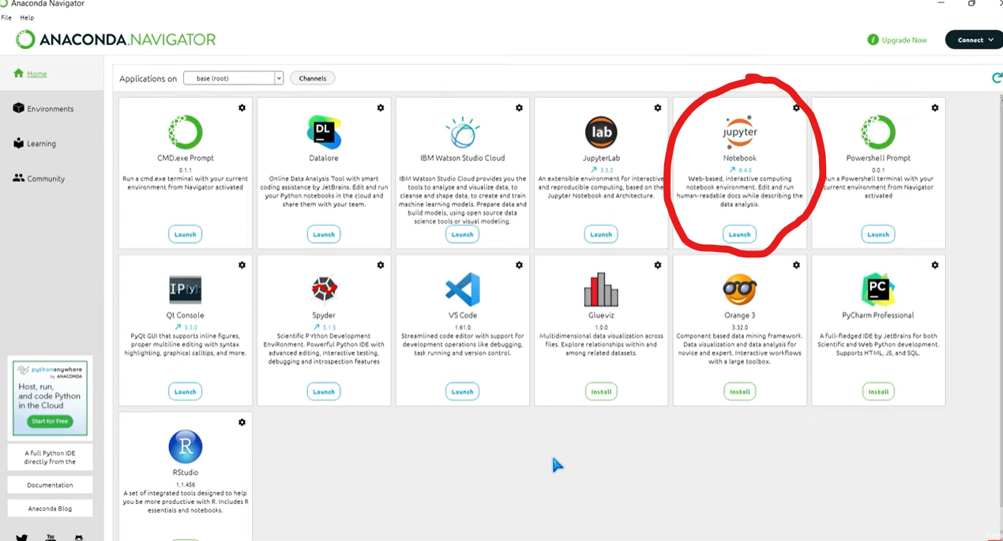
Downloading Anaconda and Jupyter notebook

Slide 4
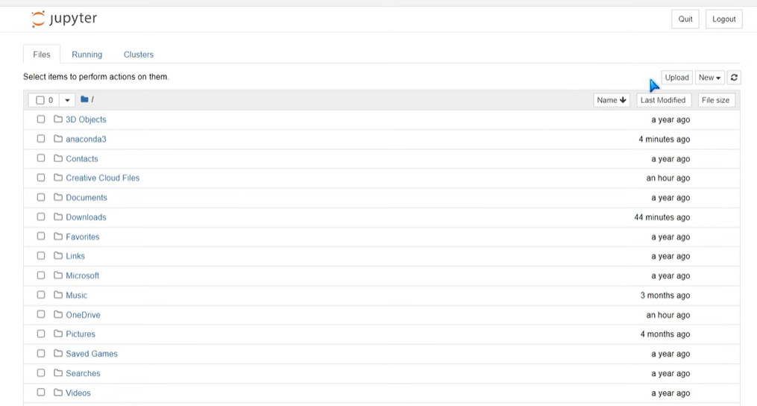
Downloading Anaconda and Jupyter notebook

Slide 5


What is Pandas
Library in python - lets you work with tabular data (like excel/ google sheets)
Python = general purpose language you use to communicate with the computer like English is for people
Analogy:
Python = the kitchen
Pandas = a tool like a set of knives, spoons, and cutting boards that make chopping, slicing, and preparing ingredients (data) much easier

Slide 6
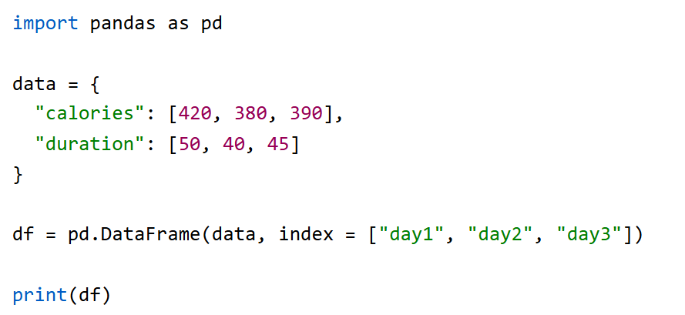
Pandas Concepts
Series = column in a table
Dataframe = 2D data structure like a table

Slide 7
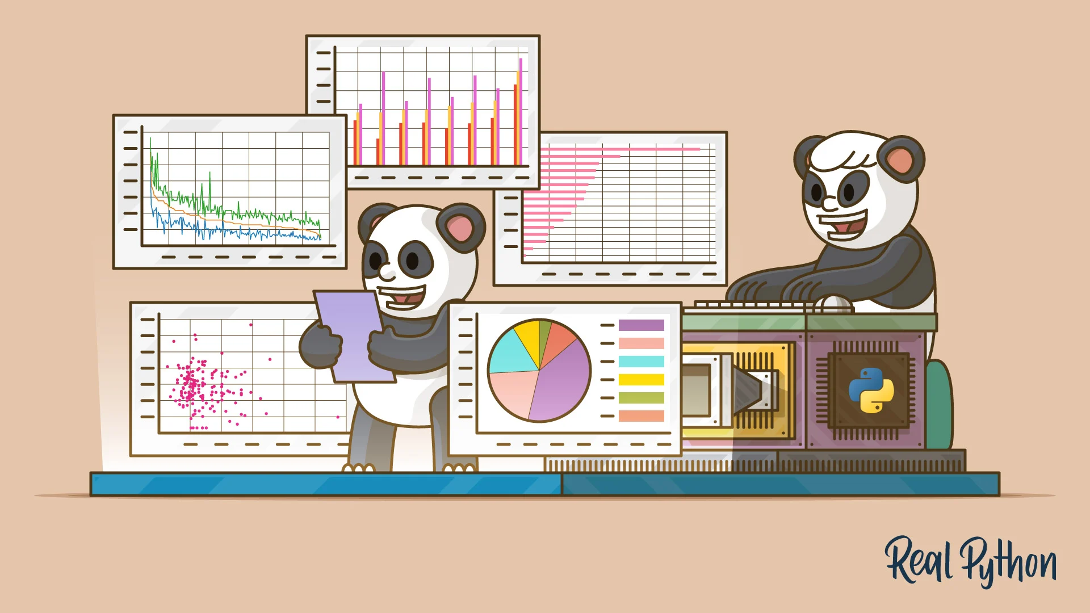
Pandas Syntax Basics
Has functions for analyzing, cleaning, exploring, and manipulating data.
Import pandas = imports the library
pd.read_csv() = reads in file
pd.Dataframe() = convert to pandas data structure
df[‘columnName’] = returns the column
df[‘columnName’].mean() = return mean of the column

Slide 8
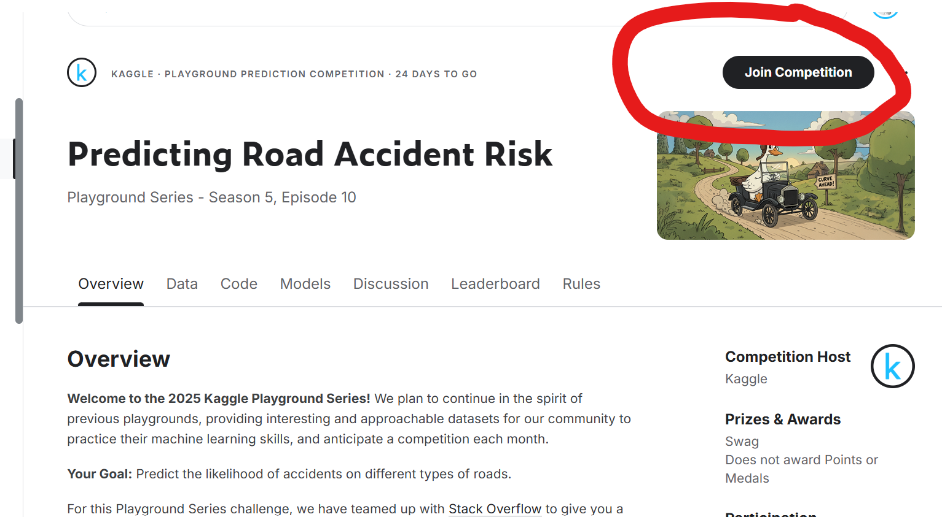
Recap: Playground Series
Link to dataset: https://www.kaggle.com/competitions/playground-series-s5e10/overview
Due: October 31 2025 11:59 PM UTC

Slide 9

Part 2: Hands on Tutorial

Slide 10
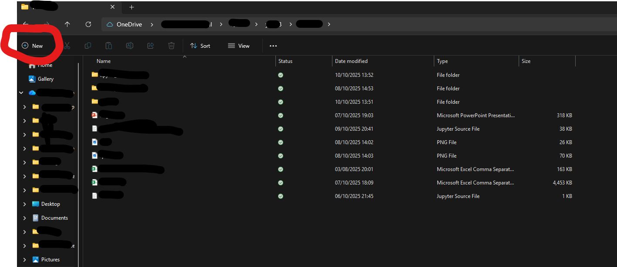
Go to Files and create a Folder
Maybe call it Kaggle or Kaggle Projects so it’s easy to find

Slide 11
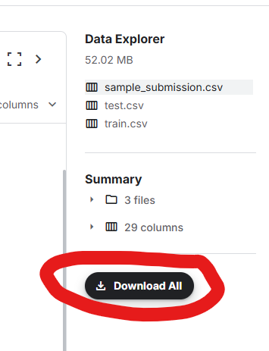
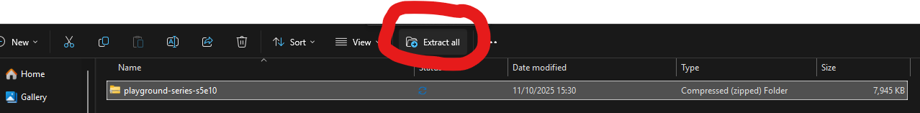
On the Kaggle website, click download all and save it to the new Folder we created in the previous step
Extract all the files in “Kaggle Projects” folder
You can go ahead and delete the old playground series folder

Slide 12
Download Template or use your own!
Go to QMML github -> then ‘Kaggle Seasons’ and download the sample template to “Kaggle Project” folder on your computer
Open Jupyter Notebook -> Navigate to “Kaggle Folder” and select this sample template notebook (.ipynb file) and open it
We can start coding!
Github link: https://github.com/Queen-Mary-Machine-Learning-Society/QMML

Slide 13
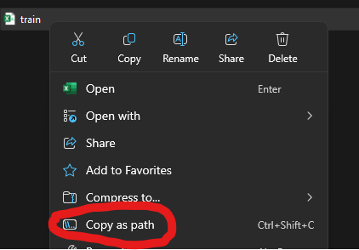
1. Importing Relevant libraries and reading in data
pd.read_csv(......) - read in data
To get the file path easily:
Right click on a dataset then select copy as path

Slide 14

2. EDA
df.head() = shows first 5 rows
Df.columns = shows all the names of the columns
Df.shape = returns the no. rows and columns
Df.describe = returns statistics about the data like mean etc.

Slide 15

3. Data Cleaning
df.isnull().sum() = checks the number of NaN (missing) values
df.drop(columns = …., axis = 1) = drops specified columns from dataset
df.dropna() = drops missing values
df.fillna()

Slide 16
4. Encoding
What it is: Converting categorical or text data into numerical form so ML models can process it.
Why it matters: Models work with numbers, not words or labels.
Types of Encoding:
Label Encoding - Assigns each category a number (e.g., Red=0, Blue=1, Green=2).
One-Hot Encoding - Creates binary columns (e.g., Red = [1,0,0], Blue = [0,1,0], Green = [0,0,1]).
Ordinal Encoding - For categories with natural order (e.g., Small=1, Medium=2, Large=3).
The right encoding depends on the type of data and model being used

Slide 17

Matplotlib
Creates high quality charts for analysis and publication.
Core library for data visualisation in ML!

Slide 18
Firstly, Import!
import matplotlib.pyplot as plt

Slide 19
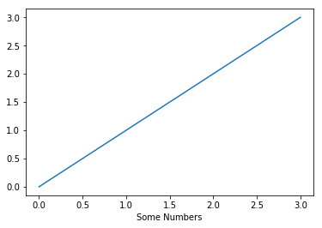
Basic Example
plt.plot([0, 1, 2, 3])
plt.xlabel("Some Numbers");

Slide 20
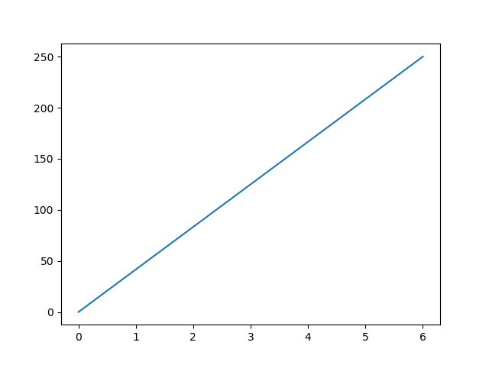
Another Example
xpoints = np.array([0, 6])
ypoints = np.array([0, 250])
plt.plot(xpoints, ypoints)

Slide 21
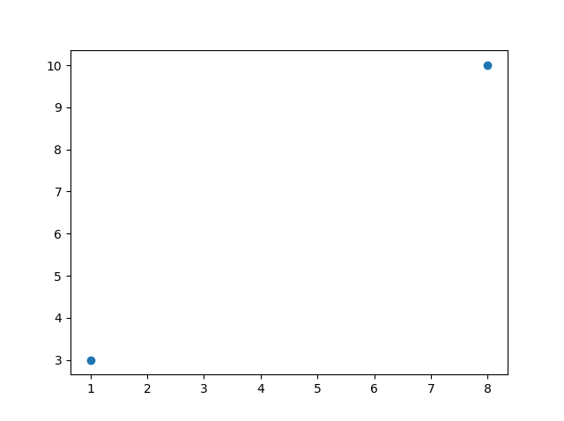
Plot without Line
Just add an ‘o’
xpoints = np.array([1, 8])
ypoints = np.array([3, 10])
plt.plot(xpoints, ypoints, 'o')

Slide 22
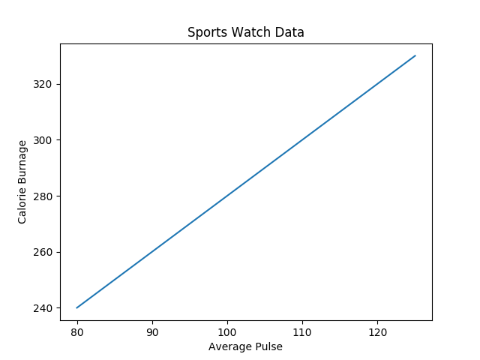
Labels
Title, xlabel, ylabel
plt.title("Sports Watch Data")
plt.xlabel("Average Pulse")
plt.ylabel("Calorie Burnage")

Slide 23

Add Grids!
with plt.grid()
plt.grid()

Slide 24

Specify Axis
plt.grid(axis = 'x')

Slide 25

Specify Axis
plt.grid(axis = 'y')

Slide 26
What can matplotlib plot?
Line Plot | plt.plot()
Scatter Plot | plt.scatter()
Bar Chart | plt.bar()
Histogram | plt.hist()
Box Plot | plt.boxplot()
Advanced | plt.figure(), plt.subplots()

Slide 27
Some real life examples!

Slide 28


Let’s Get into Teams!
Open the spreadsheet from the QR link
Pick a row and Enter your Team name + Your names
Get into teams of 3 people
Come up if you can’t find a team! We will group you up.
https://docs.google.com/spreadsheets/d/1HNIhKU8CkD-5e0b14W2KVPZ2ltB7bTK2hT_NKgNyQxI/edit?usp=drivesdk

Slide 29

Kaggle Feedback
https://forms.gle/QL4hqfEHYjAZZGiV9

